Slide 1
DISCOVERING LEARNING GROWING
BUILDING A BETTER COMMUNITY
T O G E T H E R
A COMMUNITY-CENTERED STRATEGIC DIRECTION
2016

Slide 2
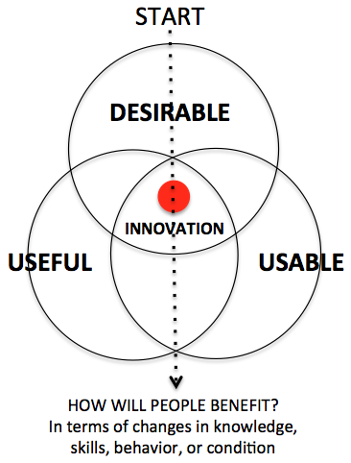
FORMULATING A COMMUNITY-CENTERED STRATEGIC DIRECTION
STRATEGIC THINKING
STRATEGIC
PLANNING
STRATEGIC
DIRECTION
+
=
UNDERSTAND
WHAT WE BELIEVE IN
WHY WE EXIST
THE COMMUNITIES THAT WE SERVE
FEED
FORWARD
OBSERVE
OBSERVE PEOPLE IN REAL-LIFE SITUATIONS
ENGAGE THEM IN CONVERSATIONS
IDENTIFY COMMUNITY ASPIRATIONS
FIND OUT WHAT’S IMPACTING THEM NOW
FEED
FORWARD
ORIENT
INTERPRET THE SITUATION BASED ON VERIFIED IMPRESSIONS AND ACTUAL DATA
FEEDBACK
FEED
FORWARD
DECIDE
HOW
WE CAN MAKE
AN IMPACT
WHERE
WE WILL
FOCUS
WHAT
ACTIONS WE
WILL TAKE
FEED
FORWARD
ACT
EXECUTE AN ADAPTIVE, PEOPLE-CENTERED APPROACH TO MAKE AND MEASURE THE IMPACT WE SET OUT TO ACHIEVE

Slide 3
LEADERSIN
LIBRARIES
2011
What We Believe In (How We Respond)
Community
We connect people with information, resources, and each other.
Learning
We encourage learning as a life-long activity and believe it is our role to help create an educated community.
Innovation
We create a dynamic environment through constant and purposeful change.
Collaboration
We work together and build partnerships to strengthen our community.

Slide 4
OUR PURPOSE – WHY WE EXIST
OUR PURPOSE – WHY WE EXIST
OUR PURPOSE – WHY WE EXIST
To Inspire our community
En rich people
Connect discovery, learning,
and growth.
Our Mission Statement
- Why We Do What We Do
- The Library’s Reason for Being
What - in the End - We
Want to Be Remembered For
CONNECT
ENGAGE
INSPIRE

Slide 5
HOW WE SEE THE FUTURE
OUR VISION – HOW WE SEE THE FUTURE
VISION
- Our Long-Term Aspirations For Our Community
- What Success Will Look Like In The Future
- Our Promise of What We Shall One Day Be
A VIBRANT, ENGAGED, AND CONNECTED COMMUNITY.

Slide 6
OUR STRATEGIES AND OUTCOMES: WHERE WE WILL FOCUS AND HOW PEOPLE BENEFIT
INVESTMENTS
Strategic Priorities and Initiatives
STRATEGIC FOCUS
DESIRED OUTCOMES
I. LEARNING
AND
EDUCATION
Position The Library As A Leader In Learning and Education In The LCSD Service Area
Impact Kindergarten Readiness
Support Learning and Education For Students K-12
Support Lifelong Learning and Skills Training Among Adults (18 and up)
A Successful, Educated Community
+
=
II. CONNECTING THE COMMUNITY
Shape and Lead Community and Civic Engagement Efforts In the LCSD Service Area
Establish and Nurture Community Partnerships
Increase Visibility and Accessibility Throughout The Service Area
Enhance Communication and Outreach Efforts
A Vibrant, Welcoming Community
+
=
IV. REIMAGINING THE LIBRARY
Align Organizational Structure and Staffing To Ensure Success In the 21st Century
Evaluate Existing Building and Surrounding Property Against Current and Future Needs
Provide Services Outside Of The Building
Improve Internal Communications
A Library That Meets the Needs of the Community
+
=

